Slide 1
OVS packet processing optimization a story on Arm architecture
December 10-11, 2019 | Westford, MA
Yanqin Wei (Arm)

Slide 2
Agenda
Performance optimization
Stability Enhancement
Public CI on Arm
Future work

Slide 3
Performance optimization on Arm on Arm
DPCLS
EMC
Partial offloading datapath
Lookup table -- Neon
DPCLS lookup -- SVE

Slide 4
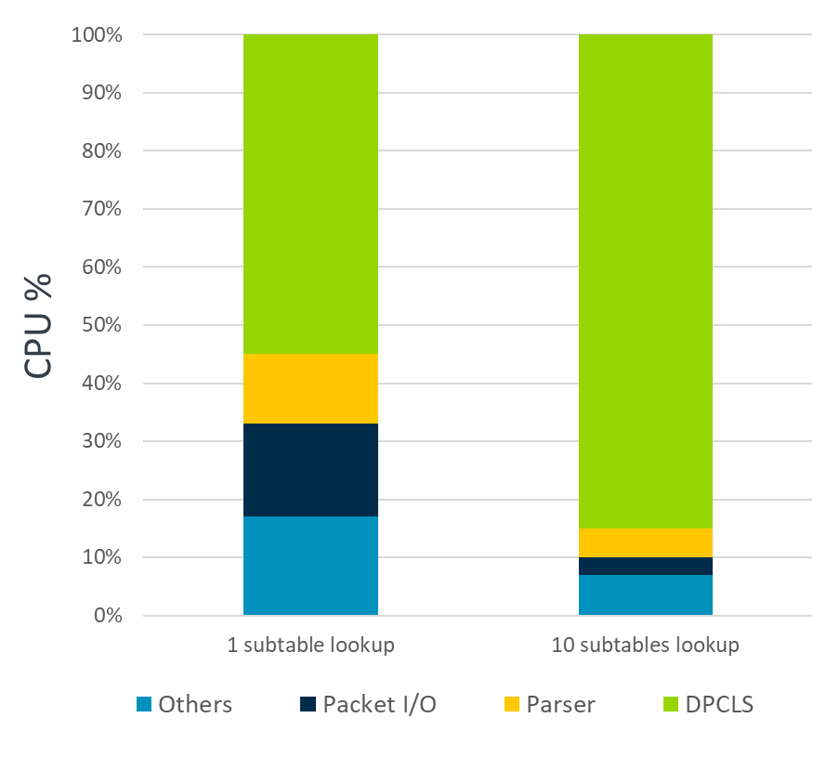
DPCLS
PHY-PHY DPCLS forwarding
IP route entry with different prefix lengths
Disabled EMC lookup
DPCLS Performance degradation with tens of subtables
DPCLS lookup is the bottleneck
1 subtable lookup | Avg. 10 subtable lookup
4.20 Mpps | 0.84 Mpps

Slide 5
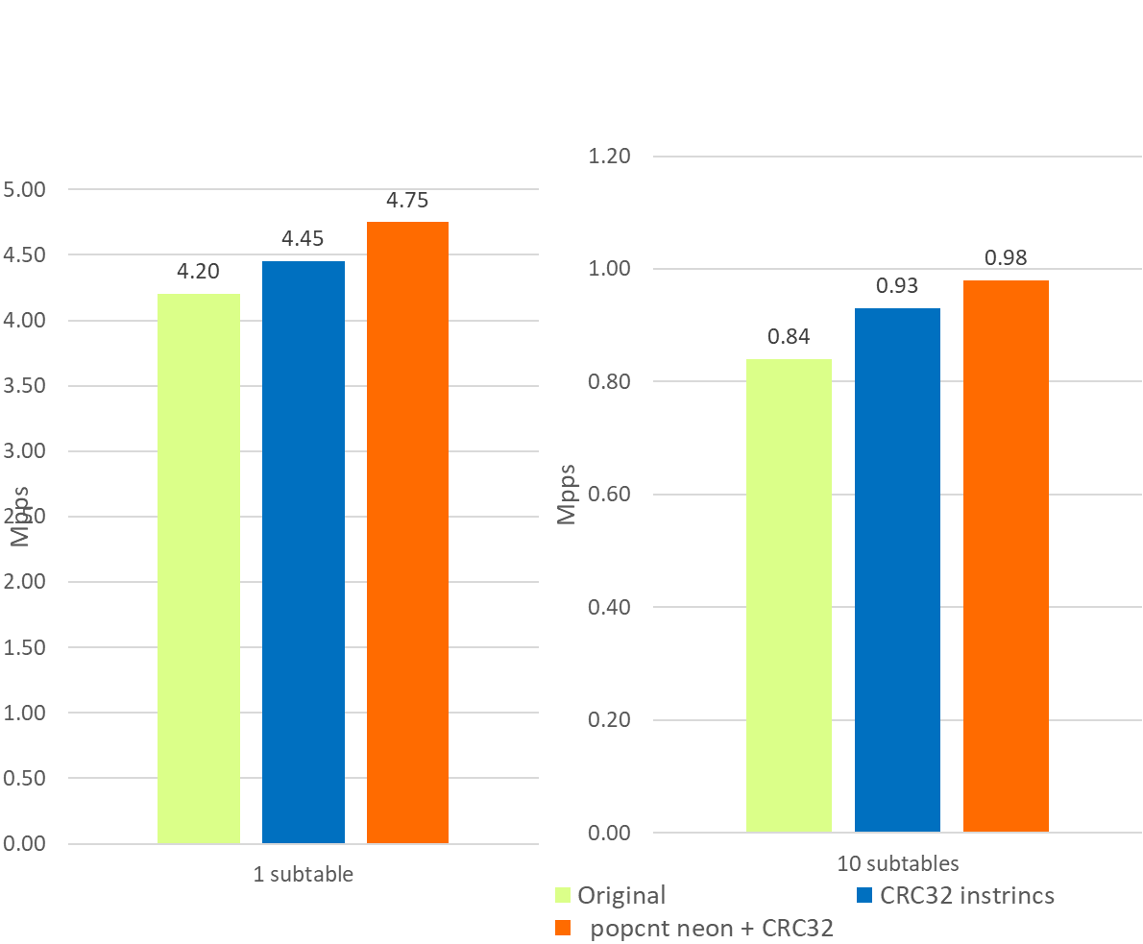
Performance optimization
Hash calculation
Accelerated hash via Arm CRC32 intrinsics
Implement count_1bits by Vcnt intrinsics
'count_1bits' operation for 'Flowmap’ and ‘packet bitmap’ significantly impact lookup performance

Slide 6
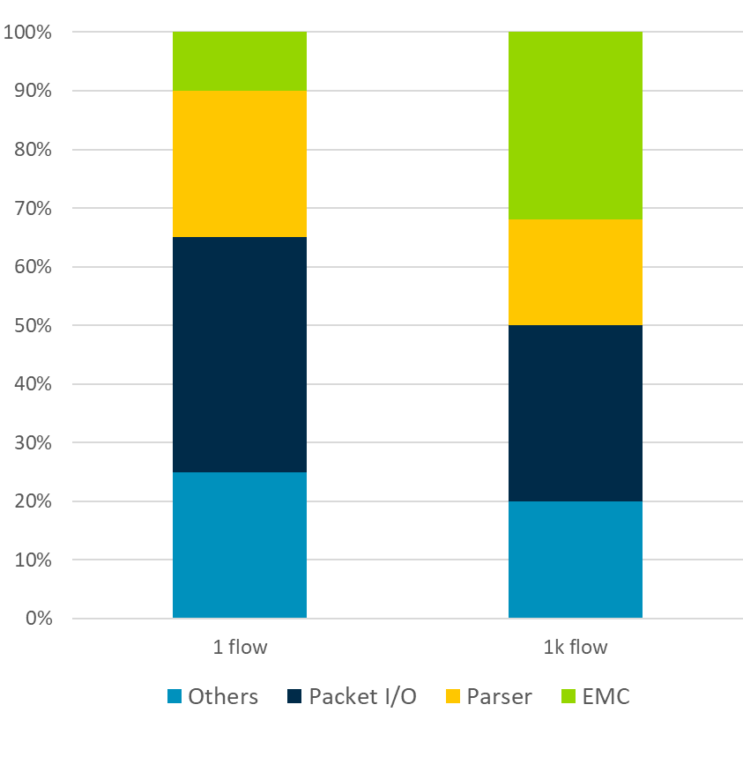
EMC
PHY-PHY EMC performance
Flow scaling is not good
Cache line missing – Prefetch EMC
Miniflow extract is another bottleneck
Heavy branchy -- Branchless
1 flow | 1k flows | 10k flows
7.85Mpps | 6.21Mpps | 5.05Mpps

Slide 7
Partial offloading datapath
Offload packet parser and cache table lookup
Skip Miniflow extract, EMC/SMC/DPCLS lookup.
Introduce Mark2flow table lookup.
Performance profiling for flow mark datapath
Arm server + SmartNIC partial offloading + Phy2Phy traffic
20.09% ovs-vswitchd [.] cmap_find
Plan to improve
Flow mark is always assigned the lowest available linear index.
Introduce scalable direct address table to OVS library.

Slide 8
Lookup Table
It is not flow cache table
An array that replaces runtime computation with a simpler array indexing operation
In OVS lib:
AES lookup table
Hexadecimal digits table
CRC32 lookup table
8F
8E
81
80
v0
⋯
v1
9F
9E
⋯
91
90
v2
AF
AE
⋯
A1
A0
v3
BF
BE
⋯
B1
B0
Table SIMD instruction
tbl / tbx: lookup bytes in 4*16B tables
tbl and tbx can be combined to use for larger table lookup
v5
01
02
10
20
49
1A
14
00
tbl v6.8b, {v0.16b-v3.16b}, v5.16b
v6
81
82
90
A0
00
9A
94
80
Notes:
One uses tbl and tbx to lookup bytes in tables on a byte-per-byte basis,
One passes up to 4 table registers for each instruction,
tbl will look up the offset from the source vector and, within the table or place a 0x00 if the offset is out of range,
tbx is similar, but preserves the source register if the index is out of range,
One typically starts with tbl and then has tbx’s for the remainder of the table,
Linux uses a table for Neon-AES, it is nearly as fast as the crypto extension!

Slide 9
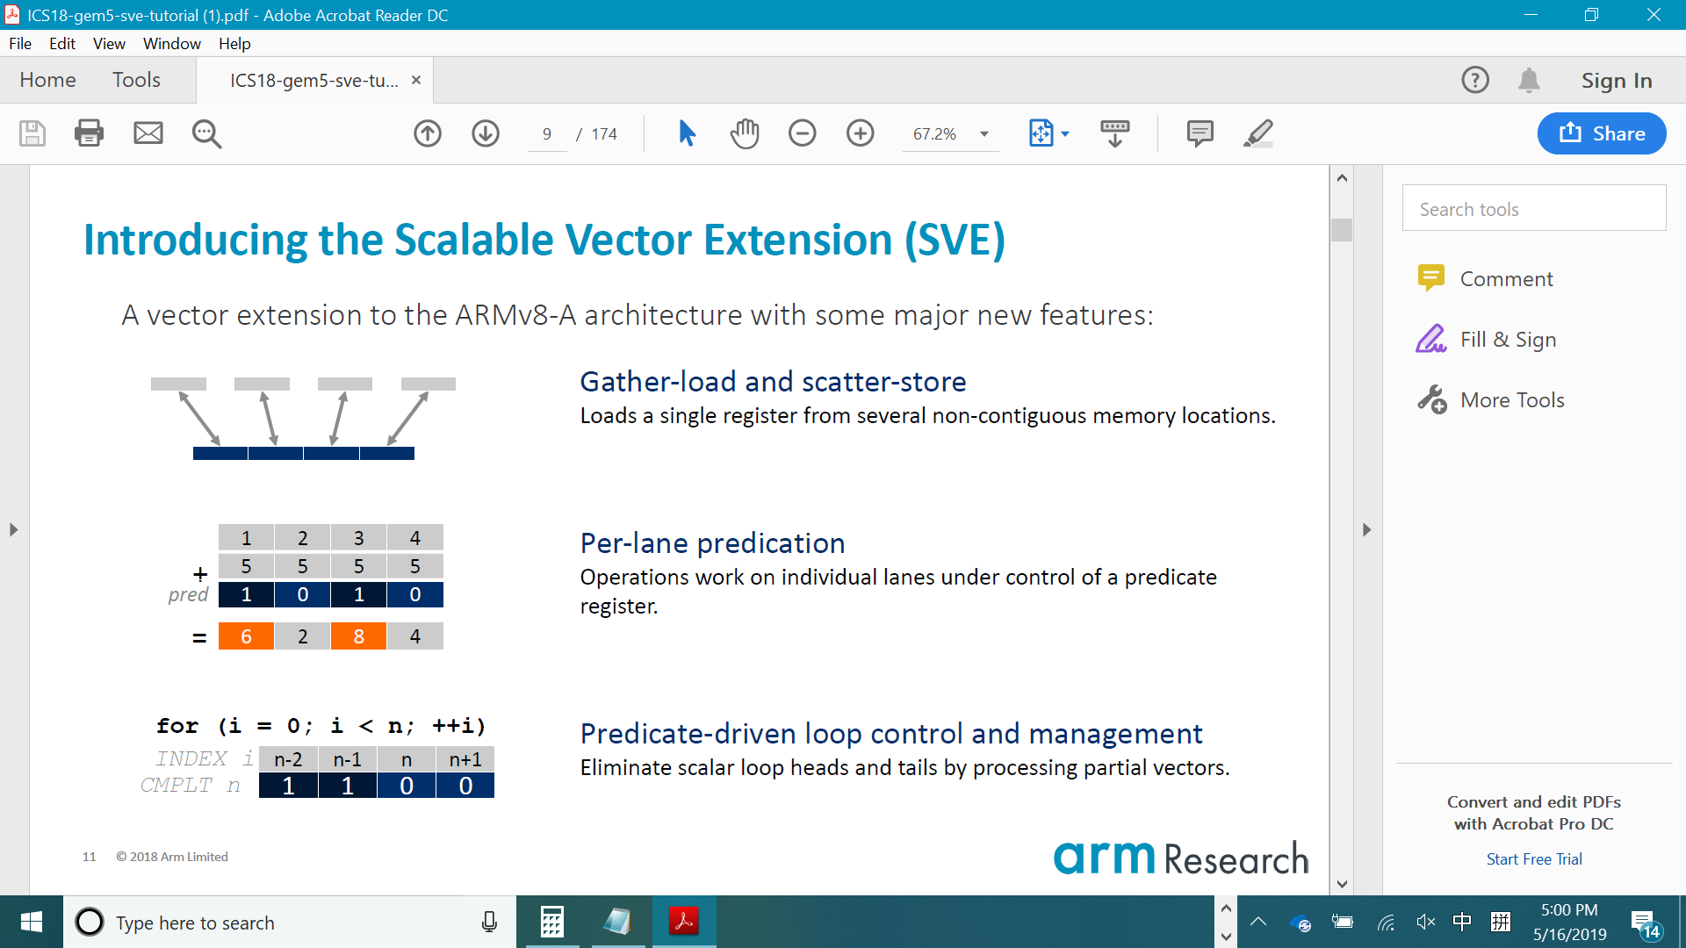
SVE for DPCLS lookup
SVE == Scalable Vector Extension
Longer SIMD register
Each element in miniflow is 64 bits. SVE register can take more element than Neon.
Gather-load and scatter-store (Gather-prefetch)
The memory to processing is not contiguous.
Per-lane predication
Key matching on individual lanes under control of a predicate register.

Slide 10
Stability Enhancement on Arm on Arm
Weak memory model
Non-blocking for critical path
Atomic feature

Slide 11
Stability - Concurrent data access
Lock
Safe but impact performance
Single Atomic operation
Independent variables
Atomic Synchronization point + normal data access
Complex interaction
Careful memory ordering
Datapath Config
Reload
Queue
Flow Mgnt
PMD thread
PMD thread
PMD thread
Fast/Slow datapath
Offloading
Status Report

Slide 12
Weak memory model
Be careful in lock-free data access
Observation order != program order
Memory re-ordering in AArch64 and x86
 | Load-Load | Load-Store | Store-Store | Store-Load
x86 | N | N | N | Y
AArch64 | Y | Y | Y | Y
Notes:
Arm reorder memory operations (no dependency)
The Arm architecture is a weakly ordered memory architecture that permits the observation and completion of memory accesses in a different order from the program order.
The dependency is not logically, the logical dependency of two variable is not visible for compiler and CPU
In x86, only Stores can be reordered after loads. TSO

Slide 13
Memory barrier Improvement
Missing memory barrier
Use one-way barrier
Only order load/store around Synchronization point in one way
AArch64 support a single instruction for this
Cmap
Load acquire counter
Store release counter +1
Insert new element
PVector
Release
thread fence
Store release new size
Write
Critical region
load acquire new size
iteration
Store release counter +2
Notes:
Difficult to reproduce this issue in lab. Find this issue by code review.

Slide 14
Stability – blocking(cmap)
Cmap – read/write concurrent access
Reader may be blocked by some other “writer” threads.
Writer does NOT run on dedicated core sometimes.
It can be rescheduled by the OS.
Reader is normally critical path.
It may be blocked if writer thread is scheduled out after making the counter be odd.
writer
counter
node
hash
reader
+1 = odd
Counter = odd
block
+1 = even
Check counter even
Check counter change
Notes:
Cmap reader may be blocked until the counter be even.

Slide 15
Remove blocking (Cmap)
Introduce a valid bitmap as guard variable for (hash,node) pair.
no spinning/waiting for writer threads to complete
non-blocking for readers
https://patchwork.ozlabs.org/patch/1196499/
writer
valid/counter
node
hash
reader
Valid =0
Valid = 0
skip
Valid = 1
Counter +1
Check valid
Check counter change
Notes:
introduces a bitmap as guard variable for (hash,node) pair. Writer need set slot valid bit to 0 before each change. And after change, writer sets valid bit to 1 and increments counter. Thus, reader can ensure slot consistency by only scanning valid slot and then checking counter+bitmap does not change while examining the bucket.
The only time a reader has to retry the read operation for single bucket is when
1)a writer clears a bit in the valid bitmap between a reader's first and second read of the counter+bitmap.
2)a writer increments the counter between a reader's first and second read of counter+bitmap. I.e. the read operation needs to be retried when some other thread has made progress (with a write). There is no spinning/waiting for other threads to complete. This makes the design non-blocking (for readers). And it has almost no additional overhead because counter and bitmap share one 32 bits variable. No additional load/store for reader and writer.

Slide 16
Remove blocking(Lock-free FIFO)
Lock-free FIFO + RCU
Remove lock for PMDs <-> other threads (i.e. offloading)
LL/SC solves ABA problem
LL/SC detects a modification, and this
gives us protection from the ABA problem
Enqueue
Tail
Head
Dequeue
1. CAS tail
CAS head
2. CAS next
ldxr
retry
stxr
cmp
Notes:
Load Linked and Store Conditional
Load/store exclusive, as well as its variants, like acquire/release, relies on compare and retry to fulfill the atomicity(when the other threads get in)
LSE atomic instructions remove the gap allowing the get-in by other threads.

Slide 17
Atomic feature
exclusive
Packet statistic
Counter sometimes are shared by multiple PMD threads
Update counter cross threads leads to cache line bouncing.
Armv8.1 atomic feature
New atomic instruction(CAS/Ldadd/SWAP)
Atomic instructions can be performed remotely instead of requiring an L1 cache fill.
Not benefit all cases. Still under investigation.
core
core
load
store
Local Cache
counter
counter
Local Cache
invalid
Cache Coherent Interconnect
counter
L3 cache or Memory
Notes:
Armv8.1 features atomic instructions, like ldadd, stadd, …… it is an alternative to load/store exclusive.
Load/store exclusive, as well as its variants, like acquire/release, relies on compare and retry to fulfill the atomicity(when the other threads get in)
LSE atomic instructions remove the gap allowing the get-in by other threads.

Slide 18
Public CI on Arm
Travis Ci has been supported on native Arm server.
Most of build jobs on Arm passed. Patch is under review.
Some UT cases failure on Arm. Request help from community!
Please find unit test failure reports and log below:
bfd decay on at: bfd decay failure report
Python IDL reconnect zip: IDL reconnect failure log for zip package including all the logs
Python IDL reconnect testsuite.log: IDL reconnect testsuit.log

Slide 19
Future work
Memory ordering and non-blocking optimization for concurrent data access.
Fast path performance improvement
AArch64 feature enablement
Public Arm CI

Slide 20
Question
Any feedback and discussion are welcome.
Yanqin.Wei@arm.com

Slide 21
Backup

Slide 22
Tables SIMD
v0
8F
8E
⋯
⋯
81
80
movi v7.8b, #0x40
sub v7.8b, v5.8b, v7.8b
v1
9F
9E
⋯
⋯
91
90
v2
AF
AE
⋯
⋯
A1
A0
v7
C1
C2
D0
E0
09
DA
D4
C0
v3
BF
BE
⋯
⋯
B1
B0
tbx v6.8b, {v4.16b}, v7.8b
v4
FF
FE
⋯
⋯
F1
F0
v6
81
82
90
A0
F9
9A
94
80
v5
01
02
10
20
49
1A
14
00
tbl v6.8b, {v0.16b-v3.16b}, v5.16b
v6
81
82
90
A0
00
9A
94
80

